Slide 1
Chapter 7
Creational Design Pattern
Factory
Singleton
Abstract Factory
Prototype

Slide 2
7.1 - Factory Design Pattern

Slide 3
Design Purpose
Factory
Create individual objects in situations where the constructor alone is inadequate.
Design Pattern Summary
Use methods to return required objects.
Adapted from Software Design: From Programming to Architecture by Eric J. Braude (Wiley 2003), with permission.

Slide 4
Factory Interface for Clients
Demonstrates the use of a static method to create an instance of a class
public static void main(String[] args)
{
RequiredClass instanceOfRequiredClass = MyClass.getNewInstanceOfRequiredClass();
} // End main

Slide 5
Factory Class Model
Client
RequiredClass
«create object»
Factory design pattern
MyClass
createObjectOfRequiredClass(): RequiredClass
Adapted from Software Design: From Programming to Architecture by Eric J. Braude (Wiley 2003), with permission.

Slide 6
Design Goal At Work: → Reusability and Corrrectness ←
We want to write code about automobiles in general: Code that applies to any make, exercised repeatedly (thus reliably).
Adapted from Software Design: From Programming to Architecture by Eric J. Braude (Wiley 2003), with permission.

Slide 7
Factory Example
Client
Application
of Factory
design
pattern
Automobile
createAutomobile(): Automobile
Ford
createAutomobile()
Toyota
createAutomobile()
«create object»
«create object»
Adapted from Software Design: From Programming to Architecture by Eric J. Braude (Wiley 2003), with permission.

Slide 8
Example Code
class Ford extends Automobile
{
static Automobile createAutomobile()
{
return new Ford();
} // End createAutomobile
} // End class

Slide 9
Sequence Diagram for Factory
:Client
:MyClass
:RequiredClass
createObjectOfRequiredClass()
RequiredClass()
Adapted from Software Design: From Programming to Architecture by Eric J. Braude (Wiley 2003), with permission.

Slide 10
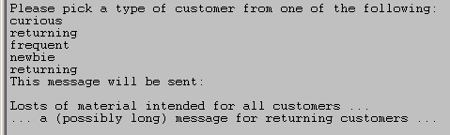
Typical Output of E-Mail Generation Example
Word that was entered
Adapted from Software Design: From Programming to Architecture by Eric J. Braude (Wiley 2003), with permission.

Slide 11
Design Goals At Work: → Correctness and Reusability ←
We want to separate the code common to all types of customers. We want to separate the specialized code that generates e-mail for each type of customer. This makes it easier to check for correctness and to reuse parts.
Adapted from Software Design: From Programming to Architecture by Eric J. Braude (Wiley 2003), with permission.

Slide 12
Factory: Email Generation Example
Application of Factory design pattern
<<abstract>>
Customer
getMessage()
Frequent
getMessage()
Returning
getMessage()
Curious
getMessage()
Newbie
getMessage()
Client
sendMessage()
«setup»
MailGenerationApplication
getCustomerTypeFromUser()
MailMessage
text
Adapted from Software Design: From Programming to Architecture by Eric J. Braude (Wiley 2003), with permission.

Slide 13
Factory Applied to getGraphics() in Java
Client
«create
object»
Factory design pattern
Component
getGraphics(): Graphics
Graphics
public static Box createVerticalBox()
public static Box createHorizontalBox()
Adapted from Software Design: From Programming to Architecture by Eric J. Braude (Wiley 2003), with permission.

Slide 14
7.2 - Singleton Design Pattern

Slide 15
Key Concept: → Singleton Design Pattern ←
-- when a class has exactly one instance.
Adapted from Software Design: From Programming to Architecture by Eric J. Braude (Wiley 2003), with permission.

Slide 16
Singleton
Design Purpose
Ensure that there is exactly one instance of a class S. Be able to obtain the instance from anywhere in the application.
Design Pattern Summary
Make the constructor of S private; define a private static attribute for S of type S; define a public accessor for it.
Adapted from Software Design: From Programming to Architecture by Eric J. Braude (Wiley 2003), with permission.

Slide 17
Design Goal At Work: → Correctness ←
Singleton enforces the intention that only one User object exists, safeguarding the application from unanticipated User instance creation.
Adapted from Software Design: From Programming to Architecture by Eric J. Braude (Wiley 2003), with permission.

Slide 18
The Singleton Interface for Clients
User mainUser = User.getTheUser();

Slide 19
Singleton: Class Model
Client
Singleton Design Pattern
MyClass
getSingletonOfMyClass(): MyClass
singletonOfMyClass
«static»
1
Adapted from Software Design: From Programming to Architecture by Eric J. Braude (Wiley 2003), with permission.

Slide 20
The Singleton Design Pattern -- applied to MyClass
Define a private static member variable of MyClass of type MyClass
private static MyClass singletonOfMyClass = new MyClass();
Make the constructor of MyClass private
private MyClass() { /* …. constructor code …. */ };
Define a public static method to access the member
public static MyClass getSingletonOfMyClass()
{
return singletonOfMyClass;
}
Adapted from Software Design: From Programming to Architecture by Eric J. Braude (Wiley 2003), with permission.

Slide 21
Application of Singleton to Experiment Example
Experiment
theExperiment: Experiment
analyze()
getTheExperiment(): Experiment
reportResults()
theExperiment
Client
«static»
1
Adapted from Software Design: From Programming to Architecture by Eric J. Braude (Wiley 2003), with permission.

Slide 22
Key Concept: → Singleton Design Pattern ←
When a class must have exactly one instance, make the constructor private and the instance a private static variable with a public accessor.
Adapted from Software Design: From Programming to Architecture by Eric J. Braude (Wiley 2003), with permission.

Slide 23
Example Code
public class Runtime
{
private static Runtime currentRuntime = new Runtime();
// Returns the runtime object associated with the current
// Java application.
public static Runtime getRuntime()
{
return currentRuntime;
}
private Runtime() { }
}

Slide 24
7.3 - Abstract Factory Design Pattern

Slide 25
Design Purpose
Abstract Factory
“Provide an interface for creating families of related or dependent objects without specifying their concrete classes.”*
Design Pattern
Capture family creation in a class containing a factory method for each class in the family.
* Gamma et al
Adapted from Software Design: From Programming to Architecture by Eric J. Braude (Wiley 2003), with permission.

Slide 26
Word Processor Interaction 1 of 2
---> Enter title:
My Life
---> Enter Heading or “-done”:
Birth
---> Enter text:
I was born in a small mountain hut ….
---> Enter Heading or “-done”:
Youth
---> Enter text:
I grew up playing in the woods …
---> Enter Heading or “-done”:
Adulthood
….
---> Enter Heading or “-done”:
-done
(continued)
Adapted from Software Design: From Programming to Architecture by Eric J. Braude (Wiley 2003), with permission.

Slide 27
Word Processor Interaction 2 of 2: Output Options
….
>> Enter the style you want displayed:
big
….
>> Enter the style you want displayed:
small
Option 1
Option 2
----- Title: MY LIFE -----
Section 1. --- BIRTH ---
I was born in a mountain hut ….
Section 2. --- YOUTH ---
I grew up sturdy …
Section 3. --- ADULTHOOD ---
….
My Life
Birth
I was born in a mountain hut ….
Youth
I grew up sturdy …
Adulthood
Adapted from Software Design: From Programming to Architecture by Eric J. Braude (Wiley 2003), with permission.

Slide 28
Abstract Factory Interface
Client
Abstract Factory*
AbstractFactory
getAPart1Object()
getAPart2Object()
Ensemble
setAbstractFactory()
doAFunction()
StyleAFactory
StyleBFactory
Style….
* relationships within pattern application not shown
Adapted from Software Design: From Programming to Architecture by Eric J. Braude (Wiley 2003), with permission.

Slide 29
Interface of Abstract Factory Applied to Word Processor
Application of Abstract Factory
Document
setStyle()
display()
1
Style
SmallStyle
LargeStyle
. . . . . . .
Client
Adapted from Software Design: From Programming to Architecture by Eric J. Braude (Wiley 2003), with permission.

Slide 30
Abstract Factory
AbstractFactory
getAPart1Object()
getAPart2Object()
Ensemble
doAFunction()
abstractFactory
1
1..n
1..n
Part1
Part2
Part…
Part1StyleA
Part1StyleB
Part2StyleA
Part2StyleB
«create»
StyleAFactory
StyleBFactory
Style….
Client
Adapted from Software Design: From Programming to Architecture by Eric J. Braude (Wiley 2003), with permission.

Slide 31
Sequence Diagram for Abstract Factory
:Client
abstractFactory
:StyleXFactory
:Ensemble
}
abstractFactory
:AbstractFactory
StyleXFactory()
Selecting a style
setAbstractFactory
(abstractFactory )
:Part_iStyleX
}
doAFunction()
getAPart_i()
Assume that this method requires a Part_i object.
Creating a Part_i object in required style
getAPart_i()
Part_iStyleX()
Virtual function property
Adapted from Software Design: From Programming to Architecture by Eric J. Braude (Wiley 2003), with permission.

Slide 32
Design Goals At Work: → Correctness and Reusability ←
We want to separate the code parts that format the document in each style. We also want to separate the common document generation code. This facilitates reusing parts and checking for correctness.
Adapted from Software Design: From Programming to Architecture by Eric J. Braude (Wiley 2003), with permission.

Slide 33
Abstract Factory Applied to Word Processor
Document
getAHeading()
getATitle()
grtDocumentFromUser()
style
Style
getAHeading()
getATitle()
Displayable
display()
0..n
0..n
Text
value
Heading
value
1
Title
value
Displayable
SmallHeading
display()
LargeHeading
display()
SmallTitle
display()
LargeTitle
display()
«create»
SmallStyle
getAHeading()
getATitle()
LargeStyle
getAHeading()
getATitle()
Client
getStyleFromUser()
displayDocument()
Adapted from Software Design: From Programming to Architecture by Eric J. Braude (Wiley 2003), with permission.

Slide 34
An Abstract Factory Application: Java ToolKit
ImagePeer
ToolKit
createButton()
createImage()
ImagePeer implementation 3
ButtonPeer
ButtonPeer implementation 3
ConcreteToolkit1
createButton()
createImage()
ConcreteToolkit2
createButton()
createImage()
ConcreteToolkit3
createButton()
createImage()
Adapted from Software Design: From Programming to Architecture by Eric J. Braude (Wiley 2003), with permission.

Slide 35
Abstract Factory: Narrow Interface
Client
AbstractFactory
getAPart1Object()
getAPart2Object()
Ensemble
setStyleA()
setStyleB()
…
abstractFactory
1
StyleAFactory
StyleBFactory
Style….
. . . .
Adapted from Software Design: From Programming to Architecture by Eric J. Braude (Wiley 2003), with permission.

Slide 36
Key Concept: → Abstract Factory Design Pattern ←
To design an application in which there are several possible styles for a collection of objects, capture styles as classes with coordinated factory methods.
Adapted from Software Design: From Programming to Architecture by Eric J. Braude (Wiley 2003), with permission.

Slide 37
7.4 - Prototype Design Pattern

Slide 38
Design Purpose
Prototype
Create a set of almost identical objects whose type is determined at runtime.
Design Pattern
Assume that a prototype instance is known; clone it whenever a new instance is needed.
Adapted from Software Design: From Programming to Architecture by Eric J. Braude (Wiley 2003), with permission.

Slide 39
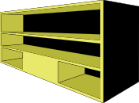

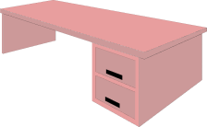
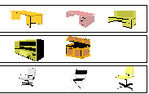
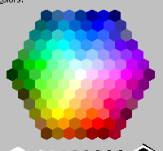
Prototype Design Example:
A Selection
Graphics courtesy COREL
Furniture color
Click on choice of desk:
Furniture hardware type
Click on choice of storage:
Click on choice of chair:
colonial

Slide 40
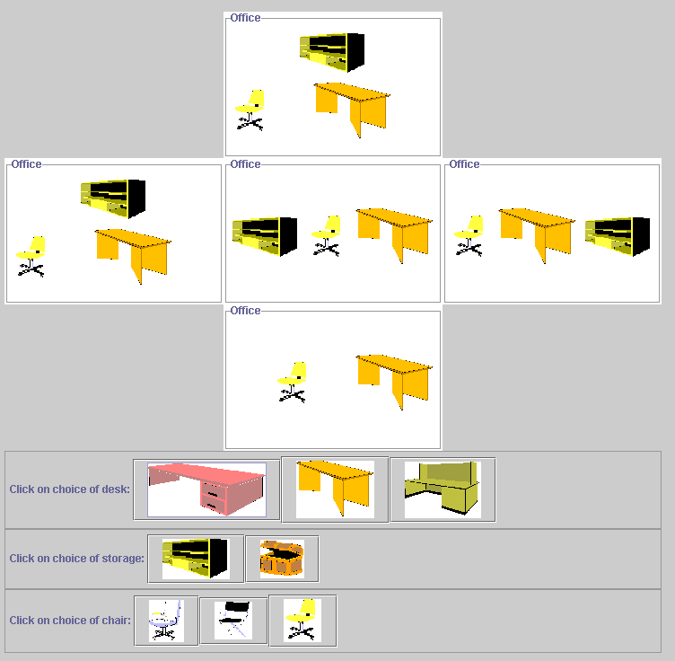
A Simplified Prototype Example
Adapted from Software Design: From Programming to Architecture by Eric J. Braude (Wiley 2003), with permission.

Slide 41
Prototype Interface With Clients
Client
(optional part of interface)
Ensemble
createEnsemble()
Part1
clone()
Part2
clone()
Adapted from Software Design: From Programming to Architecture by Eric J. Braude (Wiley 2003), with permission.

Slide 42
Code Example
OfficeSuite myOfficeSuite =
OfficeSuite.createOfficeSuite( myDesk, myChair, myStorage);
myGUI.add(myOfficeSuite);
myOfficeSuite.setBackground(“pink”);

Slide 43
The Prototype Idea
Client
Prototype Design Pattern
1
Ensemble
createEnsemble()
myPartPrototype
MyPart
clone(): MyPart
// To create a MyPart instance:
MyPart p = myPartPrototype.clone();
MyPartStyleA
clone()
MyPartStyleB
clone()
Adapted from Software Design: From Programming to Architecture by Eric J. Braude (Wiley 2003), with permission.

Slide 44
Code Example
Ensemble EnsembleA Ensemble.createEnsemble(. . .);
Ensemble EnsembleB Ensemble.createEnsemble();
// This code is inside the Ensemble class
MyPart anotherMyPart = MyPartPrototype.clone();
MyPart yetAnotherMyPart = MyPartPrototype.clone();

Slide 45
Prototype Class Model
Client
.....
// To create a Part1 object:
Part1 p1 = part1Prototype.clone();
….
Ensemble
createEnsemble()
part1Prototype
part2Prototype
1
1
Part1
clone()
Part2
clone()
Part1StyleA
clone()
Part1StyleB
clone()
Part1StyleC
clone()
Part2StyleA
clone()
Part2StyleB
clone()
Part1StyleB returnObject = new Part1StyleB();
….
Adapted from Software Design: From Programming to Architecture by Eric J. Braude (Wiley 2003), with permission.

Slide 46
Sequence Diagram for Prototype
:Ensemble
partNPrototype
:PartN
partNPrototype
:PartNStyleB
:PartNStyleB
createEnsemble()
clone()
PartNStyleB()
(virtual function property)
Adapted from Software Design: From Programming to Architecture by Eric J. Braude (Wiley 2003), with permission.

Slide 47
Contrasting Abstract Factory and Prototype
Prototype allows the client to select any chair style, any desk style, and any cabinet style
This is all done separately rather than have to select an overall office style
Nevertheless, the client wants to keep a single style of chair and a single style of desk throughout the office suite

Slide 48
Design Goals At Work: → Correctness and Reusability ←
We want to isolate the parts pertaining to each type of customer. We also want to isolate the common customer code. This makes it easier to check the design and implementation for correctness, and to reuse the parts.
Adapted from Software Design: From Programming to Architecture by Eric J. Braude (Wiley 2003), with permission.

Slide 49
Prototype Example Outline
Client
OfficeProcess
doAProcess()
customerPrototype
1
Customer
clone(): Customer
HiVolCustomer
clone()
MedVolCustomer
clone()
LoVolCustomer
clone()
Adapted from Software Design: From Programming to Architecture by Eric J. Braude (Wiley 2003), with permission.

Slide 50
Requirement for (Deep) Cloning
Given:
(1) Class model:
Class1
Class2
(2) c1 an instance of Class1:
c1:Class1
c2:Class2
c1.clone should be as follows (deep clone):
c1.clone:Class1
x*:Class2
❒
In shallow cloning, c1.clone actually as follows!
c1.clone:Class1
* a clone of c2
Adapted from Software Design: From Programming to Architecture by Eric J. Braude (Wiley 2003), with permission.

Slide 51
Key Concept: → Prototype Pattern ←
-- when designing for multiple instances which are the same in key respects, create them by cloning a prototype.
Adapted from Software Design: From Programming to Architecture by Eric J. Braude (Wiley 2003), with permission.

Slide 52
Summary of Creational Design Patterns
Use Creational Design Patterns when creating complex objects
Factory when creating individuals
Singleton for exactly one individual
Abstract Factory when creating families
Prototype to “mix & match”
Adapted from Software Design: From Programming to Architecture by Eric J. Braude (Wiley 2003), with permission.

